Slide 1
ANZ Virtual Internship Task 2 (Predictive Model Building)
Ayooluwa Adedipe
Tools Used: Python Libraries- Pandas, Matplotlib, Seaborn, and Scikit Learn
Jupyter notebook containing complete codes is available at this link

Slide 2
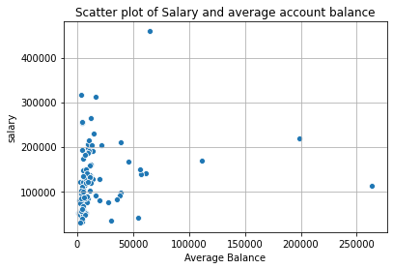
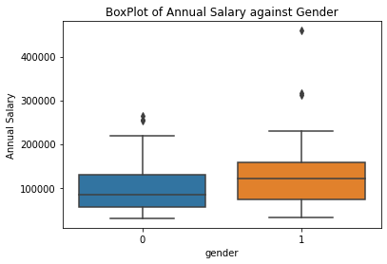
Correlations
Below are the correlation values of various features to annual salary. Average account balance has the highest positive correlation while age is negatively correlated
Feature | Correlation
Age | -0.135264
Gender | 0.154113
Location Cluster Label | 0.179398
Balance | 0.205646

Slide 3
Added Features
Average Balance: The Average account balance for all transactions (not just salary) on each account was included as an added feature.
Location Clusters: Using the Elbow method with Kmeans clustering, the longitude and latitude features were assigned three cluster labels which were another feature.

Slide 4
Predictive Models
Name | MSE Value (E9)
Baseline | 5.74
Linear Train | 4.72
Linear Test | 5.06
Decision Tree Train | 0
Decision Tree Test | 4.96
The simple Linear Regression model gave a better Mean Squared Error than the baseline prediction (using the mean of the annual salary).
However the test MSE was too high and should not be used just yet until more tuning has been carried out.
The Decision tree classifier had a better test MSE, but it can still be tuned for better performance before being deployed by ANZ
To improve the performance of both models, more data should be collected. This dataset has only 100 unique individuals in it.

